Slide 1
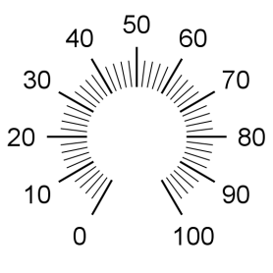
Sync
1
2
3
4
Manual
Intensity
Power

Slide 2

LED
USB
+
-
Analog/
Digital
Inputs
4 3 2 1
I2C,
External
Analog,
Current
Sense
I X I2C
Sync Output,
External
Therm
X 3 2 1
3v3
Output
4 3 2 1
14.3mm
9/16”

Slide 3
Ø90 mm
Ø3.55”
Ø90 mm
Ø3.55”

Slide 5
